Slide 1


Titolo presentazione sottotitolo
Automation of a storage warehouse Team 15
Milano, XX mese 20XX
Automation and Control Laboratory a.a. 2022/2023
Lorenzo Barone – Matteo Bartoli – Brigida Brunacci – Mario Guida

Slide 2
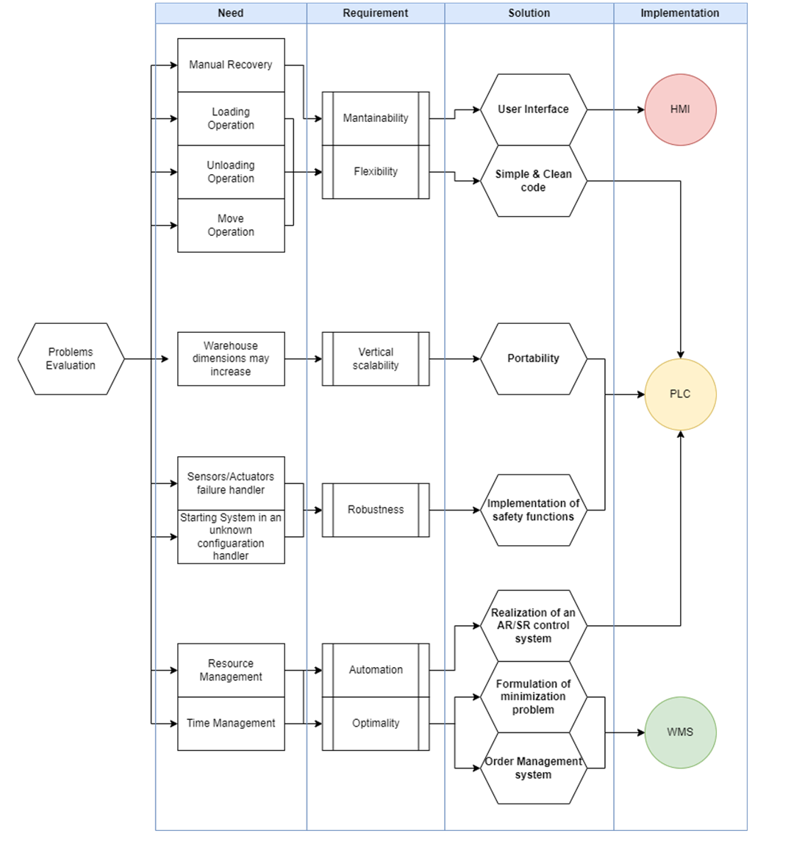
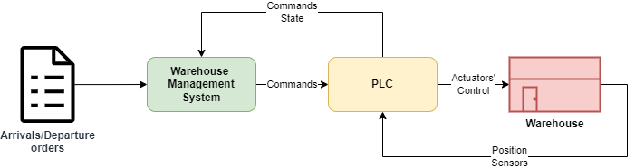
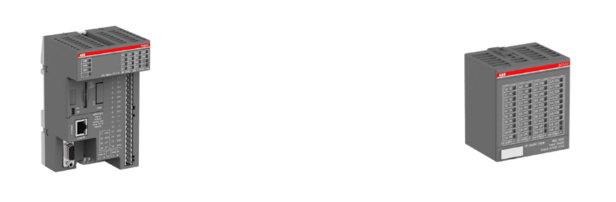
Introduction

Slide 3

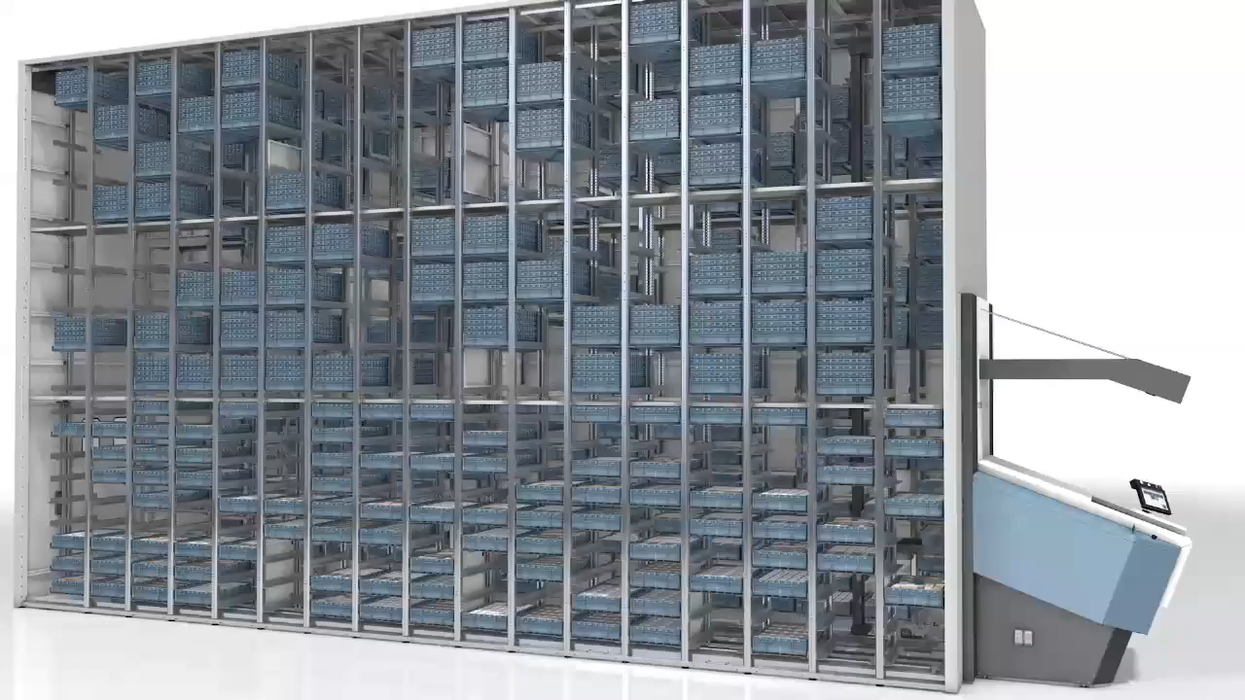
Use case

Slide 4

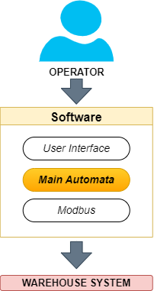

Modelling

Slide 5
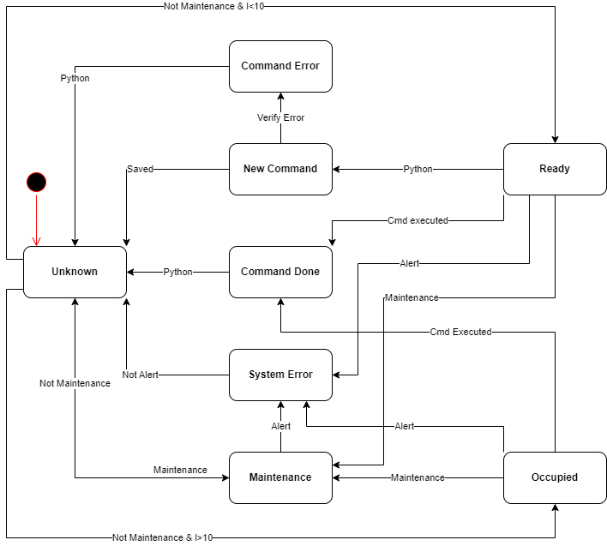
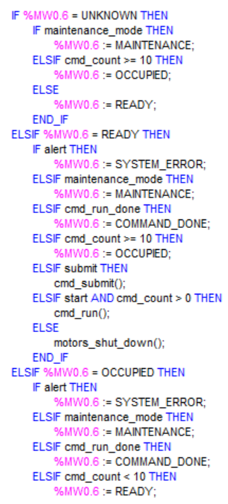
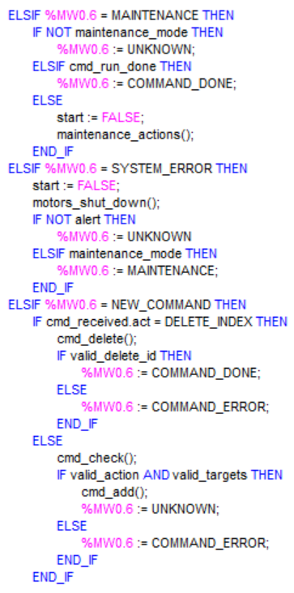
PLC Model

Slide 6
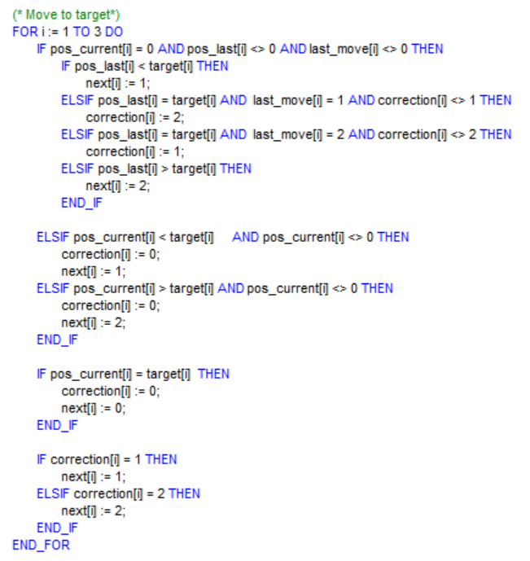
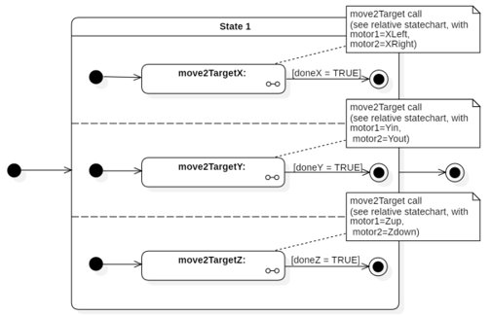
Operation’s - Model

Slide 7
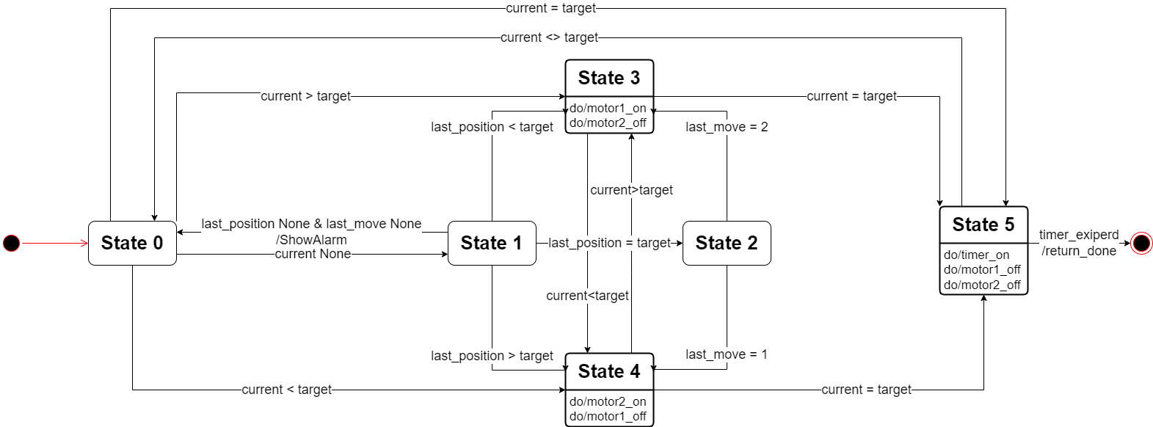
Operation’s - Model

Slide 8
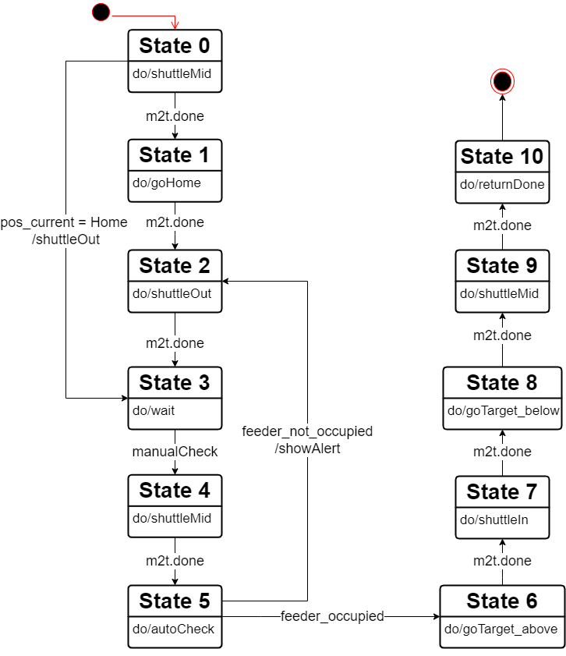
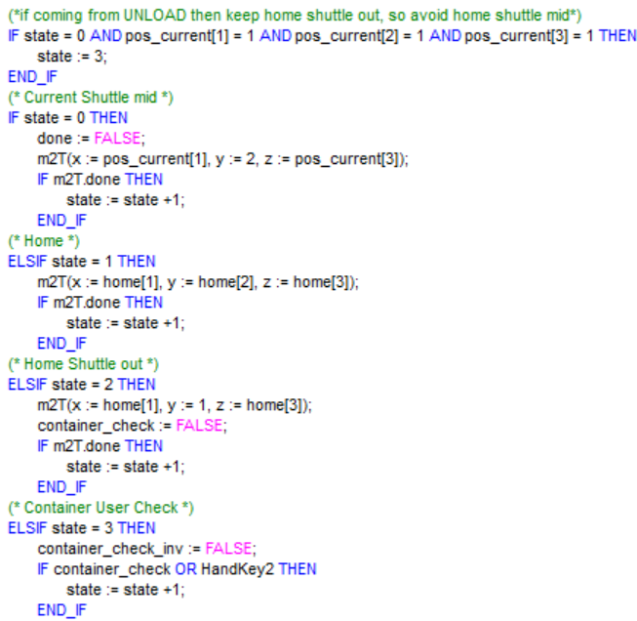
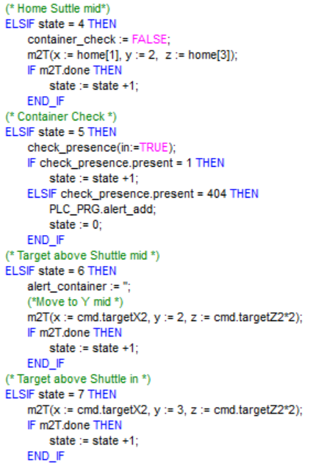
Operation’s - Load

Slide 9
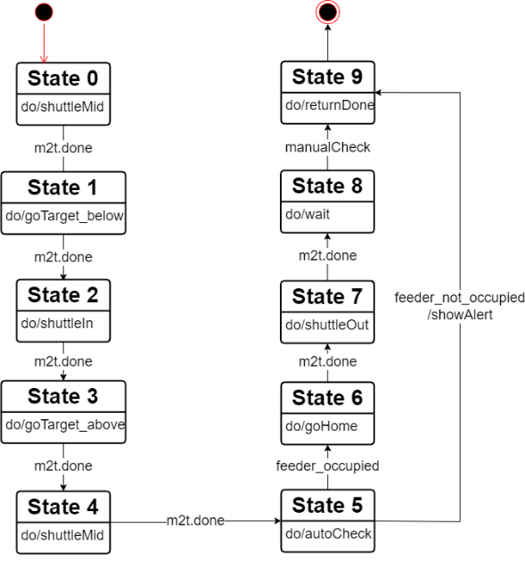
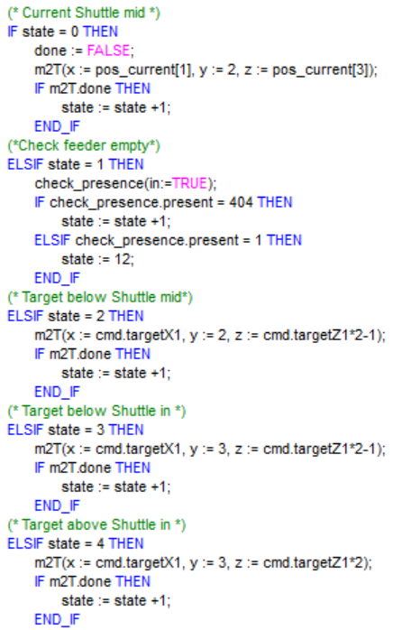
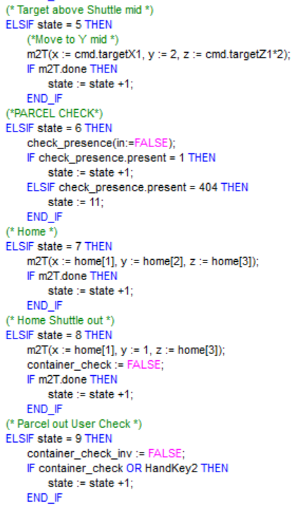
Operation’s - Unload

Slide 10
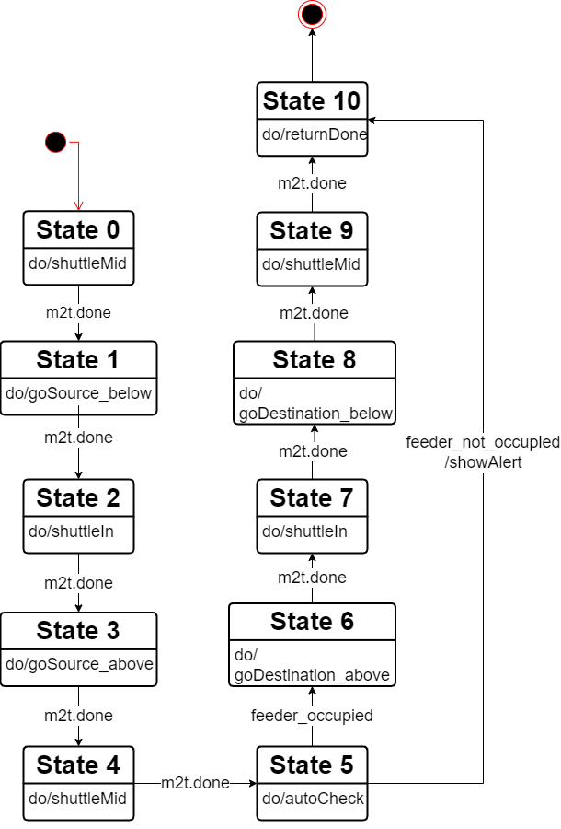
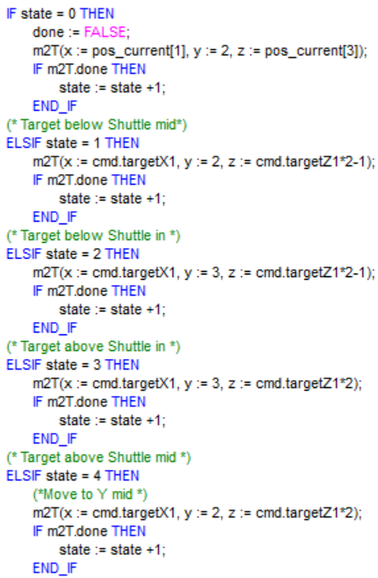
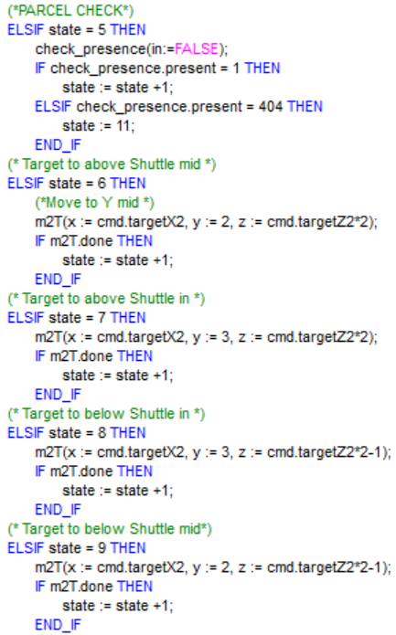
Operation’s - Move

Slide 11


Safety
Notes:
One of the objective to develop the code has been the robustness.
A code is said to be robustness if it is able to cope with erroneous input from sensor, arising from components malfunctions.
Each of these conditions can induce critical situation harmful for the system, with the risk to damage pallets or the system itself, or even to hurt an operator working near the system.
For such reasons, the develop of safety functions has been included, preventing these situations, and ensuring the correct behaviour of the system during the operations.

Slide 12
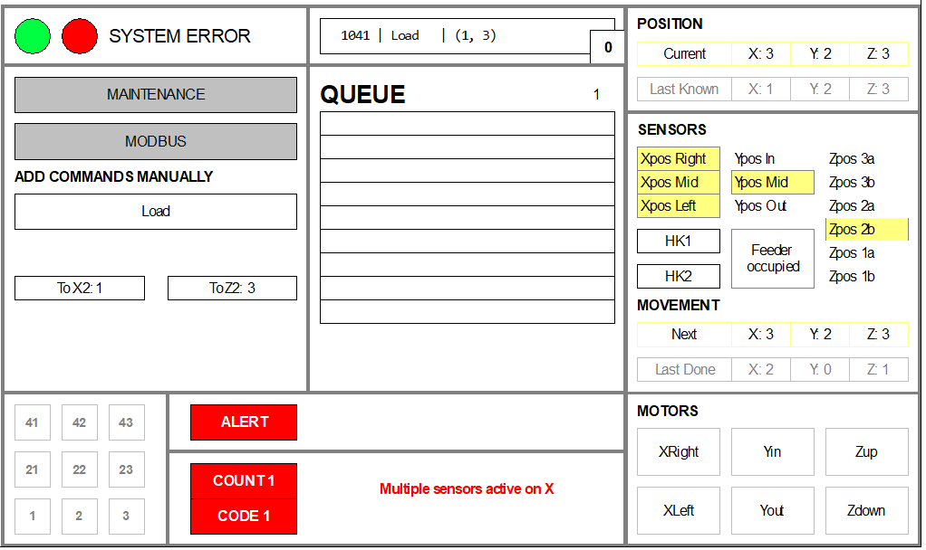
Safety – Alert Manager
Goal: avoid dangerous situations both for the structure and the operators.
Alarm generation+Stop of the system:
Manual blockage through HandKey1
Notes:
One of the objective to develop the code has been the robustness.
A code is said to be robustness if it is able to cope with erroneous input from sensor, arising from components malfunctions.
Each of these conditions can induce critical situation harmful for the system, with the risk to damage pallets or the system itself, or even to hurt an operator working near the system.
For such reasons, the develop of safety functions has been included, preventing these situations, and ensuring the correct behaviour of the system during the operations.
Alert Manager: aims to recognize all the possible malfunctions of the warehouse system.
If a malfunction is detected, an alarm is generated for the user and the system is blocked.
The possible malfunctions of the system are several
We can see alarm appear with code identifier, status of our system system error with led blinking
if there is an active alert, the last alert code is written to a specific Modbus register (%MW0.7). This allows external systems to access and process the alert information

Slide 13
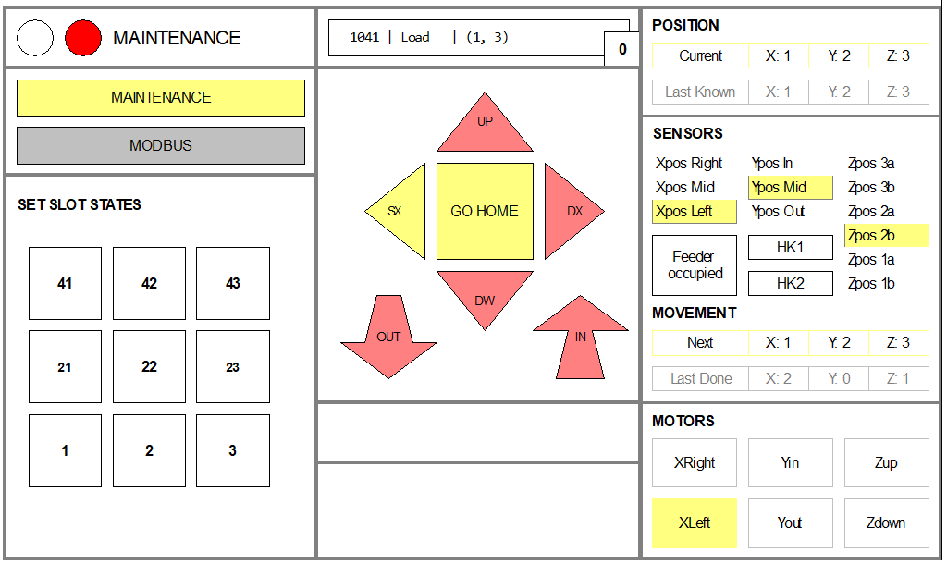
Safety – Maintenance mode
Goal: manually move the system.
All the motors will automatically turn off and are activated only through the Joystick.
Notes:
Maintenance is a mode thought to be used in emergency cases when the feeder must be moved directly by the operator.
When "Maintenance Mode" button is pressed , the system enters in the Maintenance state.
in this state all motors will be turned off and the motors will only be able to move controlled by the "Joystick"
If the system enters while a command is being executed, the progress of that command will be "frozen", the system will resume executing commands from where the operation progress was interrupted.
This mode is intended as a security function, in case there is a need to control the system "manually“ after a failure.

Slide 14

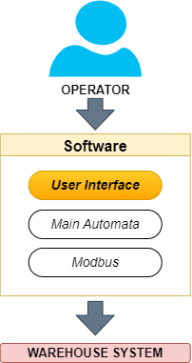

Human Machine Interface
Notes:
The HMI component is connected to the PLC. It serves as the interface through which operators interact with the system.
It allows operators to monitor and control various aspects of the warehouse operationswith a user-friendly interface for efficient interaction with the automated system.

Slide 15
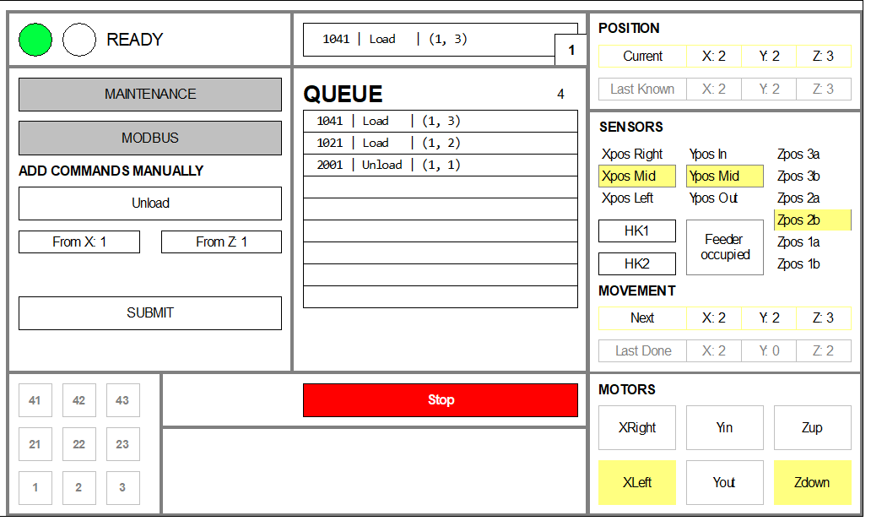
HMI - Overview
Notes:
The HMI component is connected to the PLC. It serves as the interface through which operators interact with the system.
It allows operators to monitor and control various aspects of the warehouse operations with a user-friendly interface for efficient interaction with the automated system.
Right:
-current position
-sensor status
-motor activation
-slot state with representation of their occupancy
Left:
-status of system
-selection of other views
-adding command choosing load unload delete, after choosing the target and press subit
Middle:
Queue with list of commands

Slide 16

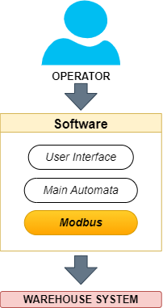

Communication

Slide 17
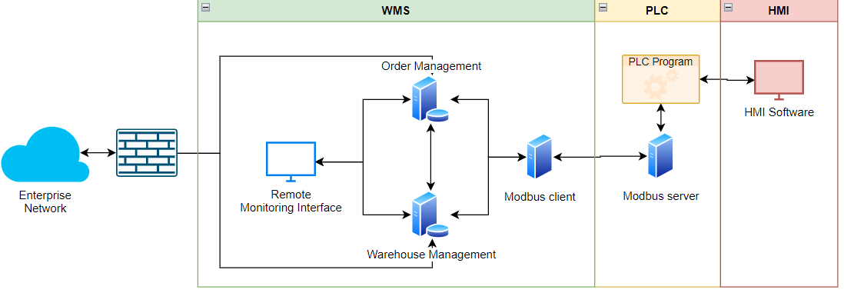
Software architecture
Notes:
The software architecture consists of three core components: HMI, PLC, WMS
• PLC (Programmable Logic Controller): The PLC component acts as the central control unit of the warehouse system. It collects and executes the PLC program.
Additionally, the PLC serves as a Modbus server, enabling communication with other devices in the system. It facilitates data exchange and coordination between the HMI, WMS, and other connected devices.
USING Modbus with TCP/IP client-server communication where the client initiates requests to read or write data from the server using the Modbus protocol over a TCP/IP PACKETS.
The TCP/IP stack ensures reliable communication, while the Modbus protocol defines the structure and function codes for data access. This approach enables seamless integration, efficient data exchange, and real-time control in industrial automation systems

Slide 18
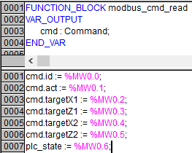
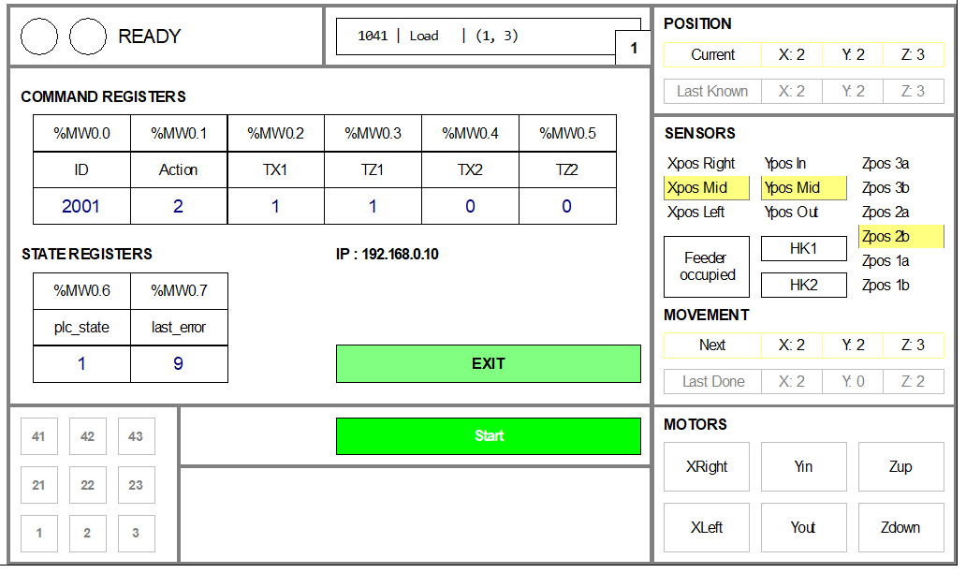
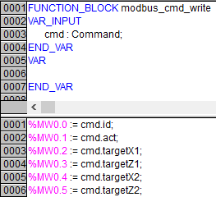
HMI – Modbus registers
Notes:
registers 0 to 7 are used to facilitate communication with Python scripts, enabling the execution of commands through the Modbus protocol
Python scripts can read from or write to these registers, enabling control and monitoring of the PLC-controlled system.
The registers serve to bridge the communication gap between the PLC and Python, facilitating the exchange of information and commands.
Machine State: Register 6 (%MW0.6): Register 6, identified, is specifically assigned to represent the machine state within the PLC. This register provides valuable information about the current operational state of the machine or a particular process.

Slide 19
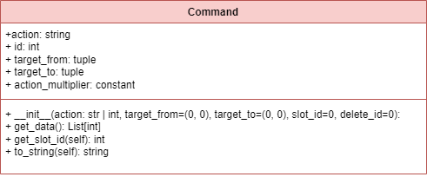
Python - PLC Library - Command
Notes:
The PLC library is a tool created to handle communication between the PLC and high-level Python programs. This library is specifically designed to integrate with our PLC program.
offers a robust framework for managing and executing commands, facilitating Modbus communication, and providing a simulated environment for testing and analysis.
There are four key classes: Command, ComunicationModule, CommandHandler and Simulator.
COMMAND:
At the core of this library is the Command class, which provides a structured and organized way to represent commands and ensures data consistency.

Slide 20
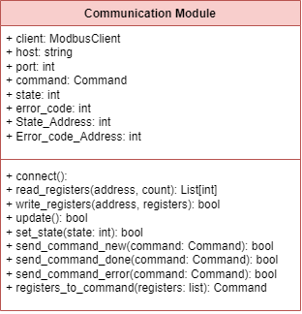
Python - PLC Library - Communication Module
Notes:
COMMUNICATION MODULE
serves as a fundamental building block, providing a reliable means to establish communication between our implemented PLCs and external systems.
Relying on the pyModbusTCP library it enhances the capability of a Modbus client handling the connection to the host via a specified port, offering methods for reading and writing the Modbus registers

Slide 21
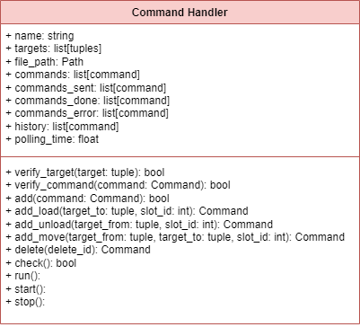
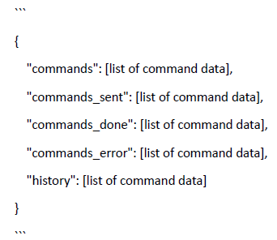
Python - PLC Library - Command Handler
Notes:
COMMAND HANDLER
extends the functionalities of the CommunicationModule , and its unique for each plc
offers a comprehensive set of methods for adding, deleting, and verifying commands, ensuring their validity and integrity before execution.
-monitors the state of the PLC and handles the commands stream accordingly.
the module has caching capabilities allowing the asynchronous management of commands with respect to the PLC state.
provides functionality for persisting data, storing in temporary files all the main variables, using the JSON format:

Slide 22
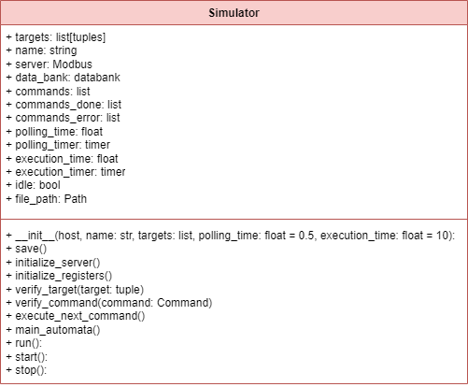
Python - PLC Library - Simulator
Notes:
SIMULATOR
The Simulator class within the library provides a simulated environment for the CommandHandler and implements the server side of the Modbus protocol allowing to test and analyze the behaviour of the system without physical connections to the PLC.
It implements the functionalities that are in our PLC program updating its state according to the main automata logics and emulating the execution of the commands setting consecutive timers. The Simulator class also facilitates the persistence of command data, ensuring that test cases and results can be stored and reused for future analysis and debugging.
Useful for validation step

Slide 23


Database & optimization algorithm
Notes:
It has been divided into several Excel sheets grouped by pertinence within the client's memory.

Slide 24
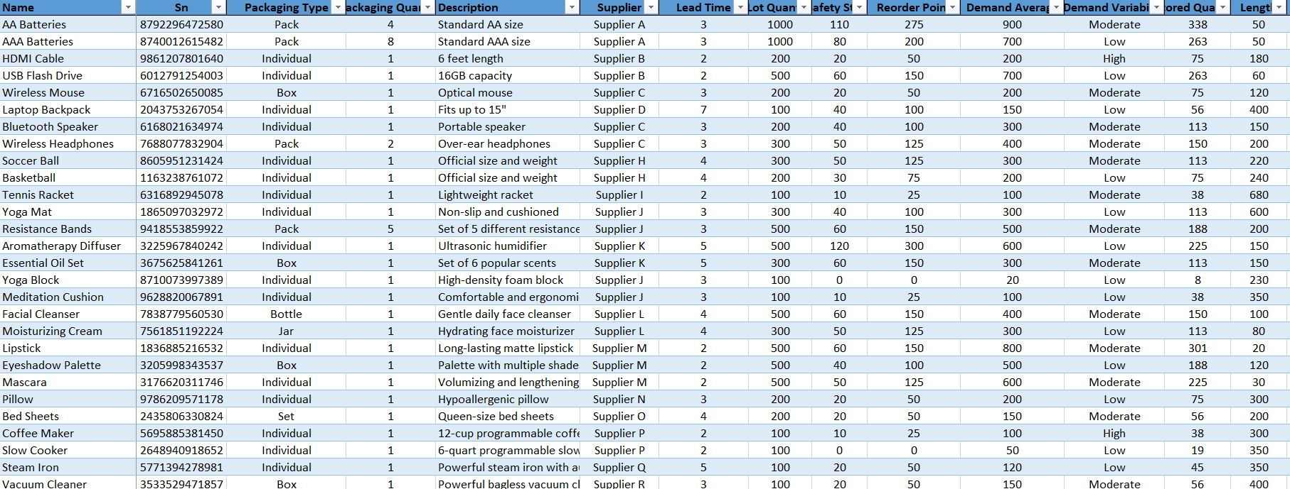
Database - Items
It contains informations regarding the products used by the warehouse manager.
Notes:
It contains various informations regarding the products, such as price, dimensions, data for efficient products supply management, marketing data and others.
Nota su stored quantity e sull’avergage demand (vedremo dopo in algoritmo di ottimizzazione)

Slide 25
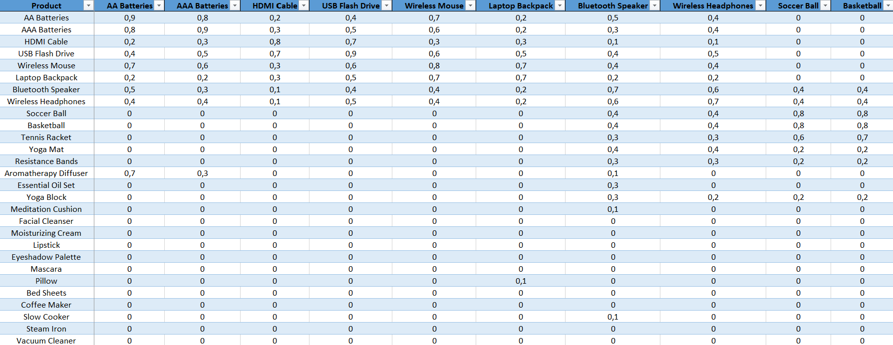
Database - Relations
The correlations matrix of the products.
Notes:
Spiegare brevemente che è indice di prodotti che sono spesso comprati assieme (vedremo dopo in algoritmo di ottimizzazione)

Slide 26
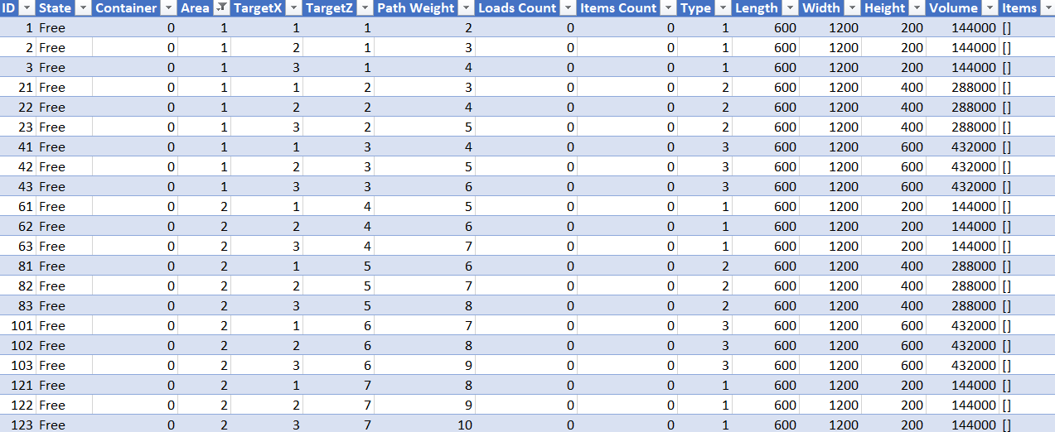
Database - Slot
Notes:
The slot database associate to each slot an ID, the state, the warehouse area, the location, type and items list
"ID" (a unique code allowing up to 5000 allocations),
"state" (describing its status as free, occupied, booked, outofservice, or maintenance),
"area" (dividing the warehouse into areas managed by different PLCs - Modbus servers),
"targetX/Z" (the coordinates of the slot within the warehouse),
"path weight" (the length of the path to reach the slot from the loading and unloading position home),
"loads/items count" (counters for warehouse performance analysis),
"type" (referring to the slot type, i.e. small, medium, large),
"width/depth/height/volume" (specifying the dimensions of the slot), and
"items" (a list of elements stored in the slot).

Slide 27
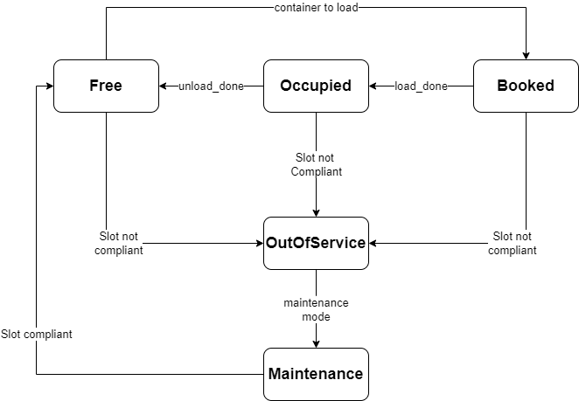
Database - Slot State
Notes:
TO BE DONE

Slide 28
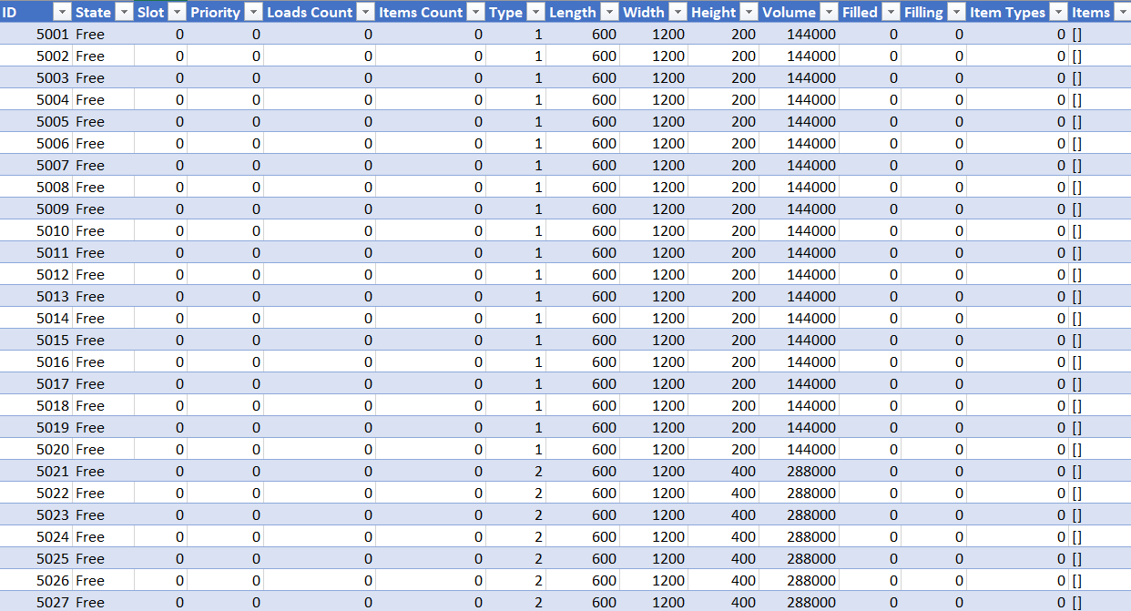
Database - Container
Notes:
"ID" (up to 5000 allocations),
"state" (describing its status as free, stored, loading, unloading, picking, retired, or waiting),
"slot" (the ID of the slot containing the container),
"priority" (managing the loading/unloading phases in an orderly manner),
"loads/items count" (counters for warehouse performance analysis),
"type/width/depth/height/volume" (similar attributes to those used for slots),
"filled/filling" (total occupied volume and percentage),
"item types" (types of elements within the container), and
"items" (a list of elements stored in the container).

Slide 29
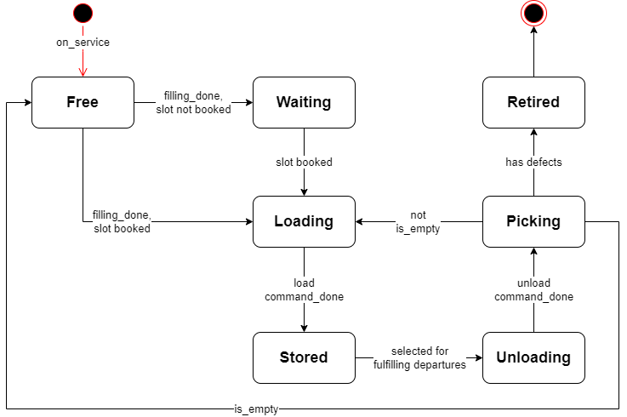
Database - Container State
Notes:
TO BE DONE

Slide 30
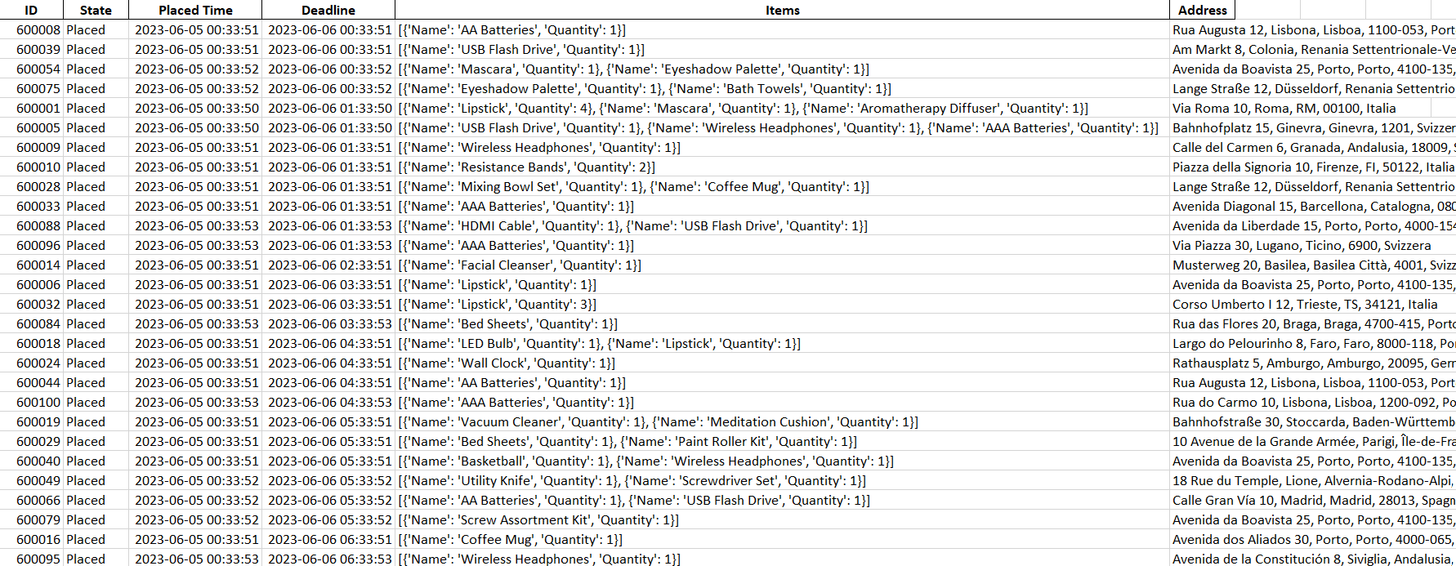
Database - Departures
Departures orders generator: the “create_departures” script is used in simulation to generate realistic outgoing orders by leveraging product data.
Notes:
It contains order data such as items and quantities, the script uses a probability distribution function and the products demand

Slide 31
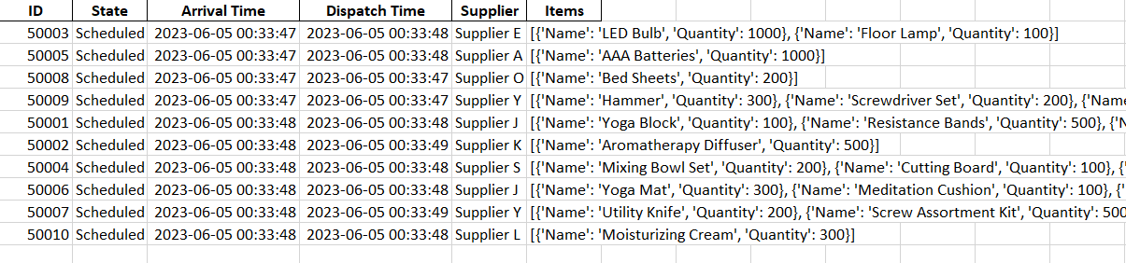
Database - Arrivals
Arrivals generator: similarly the “create_arrivals_random” script Generates supply orders by simulating the management aspect.
Notes:
Once the products from these orders are accepted by the warehouse system, they will be placed in the temporary list, which will then serve as an input to the grouping algorithm.

Slide 32
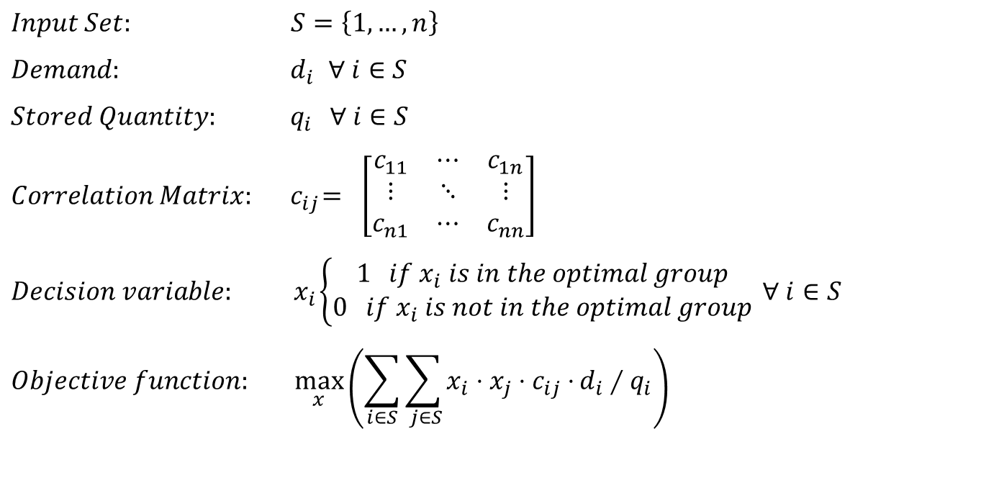
Python - Optimization algorithm
$$Input Set: S=\left\{1, …,n\right\}$$
$$Demand: { d}_{i} ∀ i∈S$$
$$Stored Quantity: { q}_{i } ∀ i∈S$$
$$Correlation Matrix:{ c}_{ij}= \left[\begin{matrix}c_{11} & ⋯ & c_{1n} \\ ⋮ & ⋱ & ⋮ \\ c_{n1} & ⋯ & c_{nn}\end{matrix}\right]$$
$$Decision variable:{ x}_{i}\left\{\begin{aligned}1 if x_{i} is in the optimal group \\ 0 if x_{i} is not in the optimal group\end{aligned}\right. ∀ i∈S$$
$$Objective function: \max_{x}\left(\sum_{i∈S}{\sum_{ j∈S}{x_{i}{⋅x}_{j} ⋅c_{ij}⋅}d_{i}∕q_{i}}\right)$$
Notes:
TO BE DONE!!
The objective function is a double sum of the products of couples xi,xj
it can be seen as the sum of all elements of a matrix Y where yij represents the presence of both elements i and j.

Slide 33
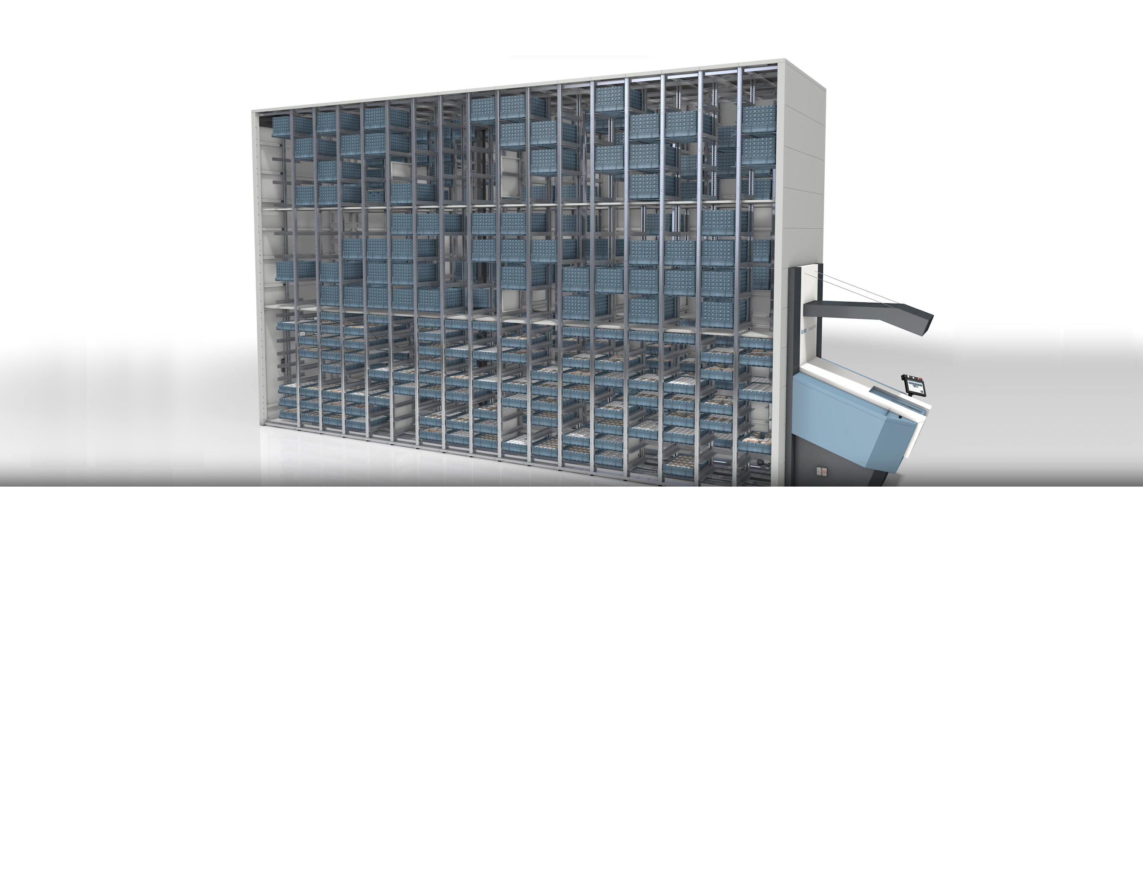

Warehouse Manager
Notes:
The warehouse manager is the high-level program designed to effectively manage the flow of goods within the warehouse incorporating various optimization algorithms.
The warehouse manager also handles various components of the warehouse, such as slots, containers, multiple areas and PLCs through specific commands.

Slide 34
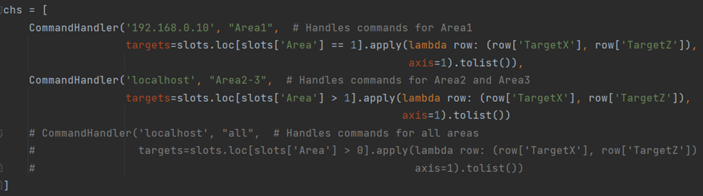
Python – Warehouse Manager Initialization and Main Loop
Initialization of multilples command handlers, one for each PLC (Area)
Main Loop
Update Arrivals
Dispatch Arrivals
Update Departures
Fulfill Departures
Save and Sleep
Check Handlers
Cmd Generation
Picking
Notes:
INITIALIZATION
At the beginning, the database tables are imported and stored in pandas DataFrames for efficient management within the program.
Then, one command handler for each plc, is defined, as representation of the relative warehouse area.
This leads to a relevant improvement in the direction of scalability.
MAIN
The program is designed to be cyclic in order to allocate resources to the various tasks with a specific priority.
And now we go deeply in the functions of the main loop.

Slide 35
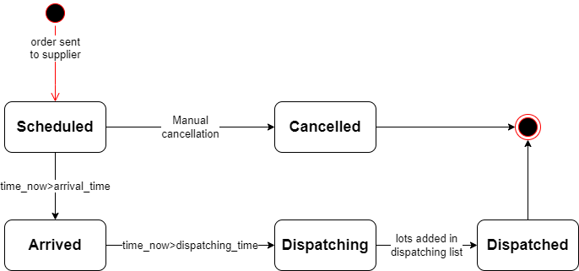

Python - Warehouse Manager - Update Arrivals
Arrival Order States
Notes:
Starting from “update arrivals”
This function checks in the database if an order is arrived, so changes its state from Scheduled to Arrived.
In a similar way it checks if the arrival can be accepted from the warehouse.
If this is the case the order is sent to the Dispatching phase. At this stage all arrived items are stored in a temporary list and the arrival is marked as Dispatched.

Slide 36
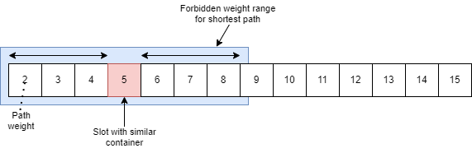
Python - Warehouse Manager - Dispatch Arrivals
Grouping algorithm: (Item types) Described before.
Filling algorithm: (Item quantities) It prioritizes an even quantity of products within the same container to improve product search during the picking phase and because the grouping algorithm ensures a strong relationship between items.
Booking algorithm: (Slots) Finds a slot with the minimum path weight that is also sufficiently distant from similar containers carrying the same type of items.
To achieve this, the algorithm establishes a range of prohibited path weights close to those of similar containers. This range gradually decreases if no suitable slots are found for loading.
Notes:
The names of the items in this temporary list are passed as input to the grouping algorithm, which as saw before returns the best group of four items to load at each iteration.
Then it search for a suitable container to store those items.
This is performed by comparing the items dimensions with those of the free containers available
Of course also the storing capability is taken into account.
Afterwards it fills the selected container with an even quantity of items.
This is done to speed up the picking phase.
At this point, we have a container filled with the selected filling percentage and it is ready to be loaded into a slot.
For doing this a slot must be booked in an intelligent way.
Indeed the booking algorithm search a slot with the minimum path weight that is also sufficiently distant from similar containers
That are the containers carrying the same type of items.
To achieve this, the algorithm establishes a range of forbidden path weights close to those of similar containers.
Eventually this range is gradually decreased if no suitable slots are found.
Finally if a slot is booked for the container, the system assigns a priority according to which the loading procedure should be take place.
Otherwise, the container goes into a "waiting" state.

Slide 37
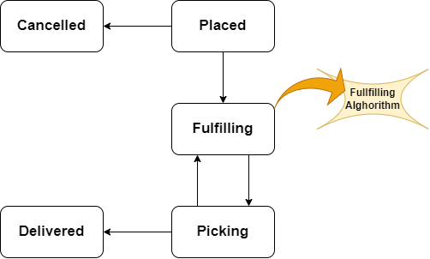
Python - Warehouse Manager Update / Fulfill Departures and Picking
Fulfilling algorithm:
Allows for managing outgoing orders from the automated warehouse by reserving the unload of the container that can unload the maximum number of items required in the first 20 incoming orders.
This optimization enhances the dispatching process.
It also checks if there is a container that will become empty if chosen to fulfill the orders, giving it priority over others. This is done to free up partially filled slots in the warehouse as soon as possible.
Departure
Order States
Notes:
Now, the next step, is to check departures.
From placed departures we select the 20 most urgent ones
relying on their deadline.
We extract their demanded items
and we search the container that fulfill the maximum number of items
to enhance efficiency.
At the same time we search if a container will be empty
if selected for the fulfilling.
If its the case this container is choosen over the optimal one.
An appropriate priority is given to the unloading procedure
and the departure goes in the picking phase.
When the container is unloaded the picking is performed, then
if the departure needs more items, it returns in the fulfilling phase,
otherwise it is marked as Delivered.
after picking
If the container is empty is marked as Free,
otherwise follows the booking procedure described before to be reloaded in the warehouse.

Slide 38
Python - Warehouse Manager Commands Generation and File Management
Commands Generation:
Generated all at once
Follow the set priority
Ensure a correct container flow.
Adding to CommandHandlers:
Commands are added to the respective Handlers.
Check PLCs through CommandHandlers:
Invoking their "check" functions, Handlers will send the commands to their PLCs.
Database is updated, relying on done commands
Saving program context:
Interrupt and resume capability
Notes:
Load / Unload commands, are generated, all at once in the program
Following the set priority, determined by the functions described previously.
This ensures the correct management of the container flow, within the system
Those generated commands, are added to their respective Handlers, using their methods.
Then those handlers are responsible, for sending commands to the physical PLC, at proper time This is done, simply by invoking the corresponding, "check" function.
After checking,
The database is updated relying on done commands, received by the handlers.
The cycle ends, saving the program context, in temporary files
This allows, to stop the execution at any time, to check or update the database, and resume from the point whare it left.

Slide 39
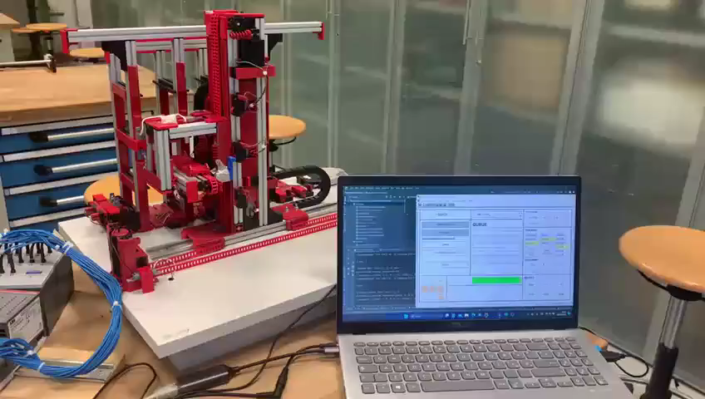
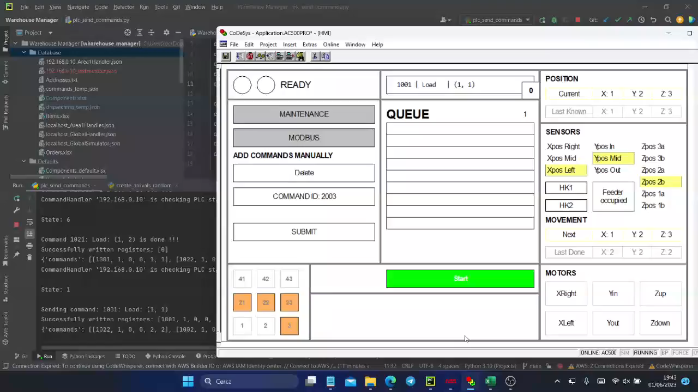
Validation

Slide 40

Future evolutions – Multiple Warehouse & SCADA

Slide 41

Questions

